Slide 1
Application Architecture

Slide 2
public void Decision2022(int b) {
try {
Connection c = DriverManager.getConnection("jdbc:mysql://localhost:3306/employees", "username", "password");
Statement d = c.createStatement();
ResultSet e = d.executeQuery("SELECT COUNT(*) FROM writeups WHERE employee_id = " + b);
e.next();
int f = e.getInt(1);
ResultSet g = d.executeQuery("SELECT * FROM employees WHERE id = " + b);
if (g.next()) {
String h = g.getString("name");
Date i = g.getDate("start");
Calendar j = Calendar.getInstance();
j.setTime(i);
Calendar k = Calendar.getInstance();
int l = k.get(Calendar.YEAR);
int m = j.get(Calendar.YEAR);
int n = l - m;
ResultSet o = d.executeQuery("SELECT SUM(duration) FROM unpaid_leave WHERE employee_id = " + b);
o.next();
int p = o.getInt(1);
n -= p;
ResultSet q = d.executeQuery("SELECT * FROM payment WHERE employee_id = " + b + " ORDER BY month DESC LIMIT 1");
if (q.next()) {
double r = q.getDouble("salary");
if (!f && n > 3 ) {
double s = r + r*0.10;
d.executeUpdate("UPDATE payment SET salary = " + s + " WHERE employee_id = " + b + " AND month = '" + q.getString("month") + "'");
}
} else {
ResultSet structureResult = d.executeQuery("SELECT standard FROM structure WHERE position = '" + g.getString("position") + "'");
if (structureResult.next()) {
double standardSalary = structureResult.getDouble("standard");
double newSalary = standardSalary * 1.10;
}
structureResult.close();
}
o.close();
} else {
System.out.println("Employee with ID " + b + " not found.");
}
e.close();
g.close();
d.close();
c.close();
} catch (SQLException t) {
t.printStackTrace();
}
}
Notes:
- Knows how to connect to the database
- Knows the table structures
-

Slide 3
public void Decision2022(int b) {
try {
Connection c = DriverManager.getConnection("jdbc:mysql://localhost:3306/employees", "username", "password");
Statement d = c.createStatement();
ResultSet e = d.executeQuery("SELECT COUNT(*) FROM writeups WHERE employee_id = " + b);
e.next();
int f = e.getInt(1);
ResultSet g = d.executeQuery("SELECT * FROM employees WHERE id = " + b);
if (g.next()) {
String h = g.getString("name");
Date i = g.getDate("start");
Calendar j = Calendar.getInstance();
j.setTime(i);
Calendar k = Calendar.getInstance();
int l = k.get(Calendar.YEAR);
int m = j.get(Calendar.YEAR);
int n = l - m;
ResultSet o = d.executeQuery("SELECT SUM(duration) FROM unpaid_leave WHERE employee_id = " + b);
o.next();
int p = o.getInt(1);
n -= p;
ResultSet q = d.executeQuery("SELECT * FROM payment WHERE employee_id = " + b + " ORDER BY month DESC LIMIT 1");
if (q.next()) {
double r = q.getDouble("salary");
if (!f && n > 3 ) {
double s = r + r*0.10;
d.executeUpdate("UPDATE payment SET salary = " + s + " WHERE employee_id = " + b + " AND month = '" + q.getString("month") + "'");
}
} else {
ResultSet structureResult = d.executeQuery("SELECT standard FROM structure WHERE position = '" + g.getString("position") + "'");
if (structureResult.next()) {
double standardSalary = structureResult.getDouble("standard");
double newSalary = standardSalary * 1.10;
}
structureResult.close();
}
o.close();
} else {
System.out.println("Employee with ID " + b + " not found.");
}
e.close();
g.close();
d.close();
c.close();
} catch (SQLException t) {
t.printStackTrace();
}
}
Notes:
- Do date calculation

Slide 4
public void Decision2022(int b) {
try {
Connection c = DriverManager.getConnection("jdbc:mysql://localhost:3306/employees", "username", "password");
Statement d = c.createStatement();
ResultSet e = d.executeQuery("SELECT COUNT(*) FROM writeups WHERE employee_id = " + b);
e.next();
int f = e.getInt(1);
ResultSet g = d.executeQuery("SELECT * FROM employees WHERE id = " + b);
if (g.next()) {
String h = g.getString("name");
Date i = g.getDate("start");
Calendar j = Calendar.getInstance();
j.setTime(i);
Calendar k = Calendar.getInstance();
int l = k.get(Calendar.YEAR);
int m = j.get(Calendar.YEAR);
int n = l - m;
ResultSet o = d.executeQuery("SELECT SUM(duration) FROM unpaid_leave WHERE employee_id = " + b);
o.next();
int p = o.getInt(1);
n -= p;
ResultSet q = d.executeQuery("SELECT * FROM payment WHERE employee_id = " + b + " ORDER BY month DESC LIMIT 1");
if (q.next()) {
double r = q.getDouble("salary");
if (!f && n > 3 ) {
double s = r + r*0.10;
d.executeUpdate("UPDATE payment SET salary = " + s + " WHERE employee_id = " + b + " AND month = '" + q.getString("month") + "'");
}
} else {
ResultSet structureResult = d.executeQuery("SELECT standard FROM structure WHERE position = '" + g.getString("position") + "'");
if (structureResult.next()) {
double standardSalary = structureResult.getDouble("standard");
double newSalary = standardSalary * 1.10;
}
structureResult.close();
}
o.close();
} else {
System.out.println("Employee with ID " + b + " not found.");
}
e.close();
g.close();
d.close();
c.close();
} catch (SQLException t) {
t.printStackTrace();
}
}
Notes:
- Knows how to calculate bonus

Slide 5
public void Decision2022(int b) {
try {
Connection c = DriverManager.getConnection("jdbc:mysql://localhost:3306/employees", "username", "password");
Statement d = c.createStatement();
ResultSet e = d.executeQuery("SELECT COUNT(*) FROM writeups WHERE employee_id = " + b);
e.next();
int f = e.getInt(1);
ResultSet g = d.executeQuery("SELECT * FROM employees WHERE id = " + b);
if (g.next()) {
String h = g.getString("name");
Date i = g.getDate("start");
Calendar j = Calendar.getInstance();
j.setTime(i);
Calendar k = Calendar.getInstance();
int l = k.get(Calendar.YEAR);
int m = j.get(Calendar.YEAR);
int n = l - m;
ResultSet o = d.executeQuery("SELECT SUM(duration) FROM unpaid_leave WHERE employee_id = " + b);
o.next();
int p = o.getInt(1);
n -= p;
ResultSet q = d.executeQuery("SELECT * FROM payment WHERE employee_id = " + b + " ORDER BY month DESC LIMIT 1");
if (q.next()) {
double r = q.getDouble("salary");
if (!f && n > 3 ) {
double s = r + r*0.10;
d.executeUpdate("UPDATE payment SET salary = " + s + " WHERE employee_id = " + b + " AND month = '" + q.getString("month") + "'");
}
} else {
ResultSet structureResult = d.executeQuery("SELECT standard FROM structure WHERE position = '" + g.getString("position") + "'");
if (structureResult.next()) {
double standardSalary = structureResult.getDouble("standard");
double newSalary = standardSalary * 1.10;
}
structureResult.close();
}
o.close();
} else {
System.out.println("Employee with ID " + b + " not found.");
}
e.close();
g.close();
d.close();
c.close();
} catch (SQLException t) {
t.printStackTrace();
}
}
Notes:
- Is this pattern of code similar to what you write?
- What is the pattern?
- Analyze the code
- Make some database query, and then do some calculation and repeat
- Some calculation are long and some are simple
- The last if does not have any use
- The code works
- What does this code do?
- First assignment in your first job?
- Rude code
- Why?
- It put together way too much info, responsible for many things
- Breaking SRP rules (Single responsibility principle) => How many responsibility this function has?
- Making it hard for you to understand
- Making it extremely difficult to change
- Where will you get this rude code?
- What is wrong with this code? (For tomorrow)
- What can be a good code

Slide 7
Type of Objects
Entities
Abstracts
Aggregates
Enums
Exceptions
Events
Exceptions
Factories
Interfaces
Services
Hydrators and Extractors
Controllers
Handlers
Middlewares
Validators
Tests

Slide 8
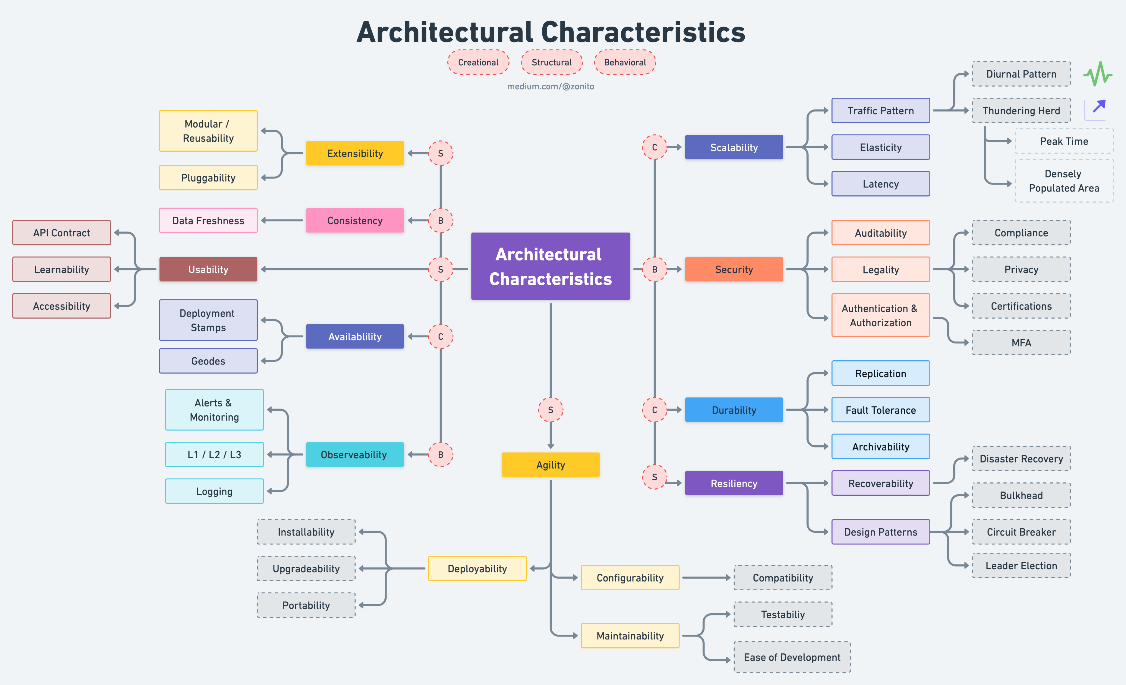

Slide 9
Clean Architecture

Slide 10
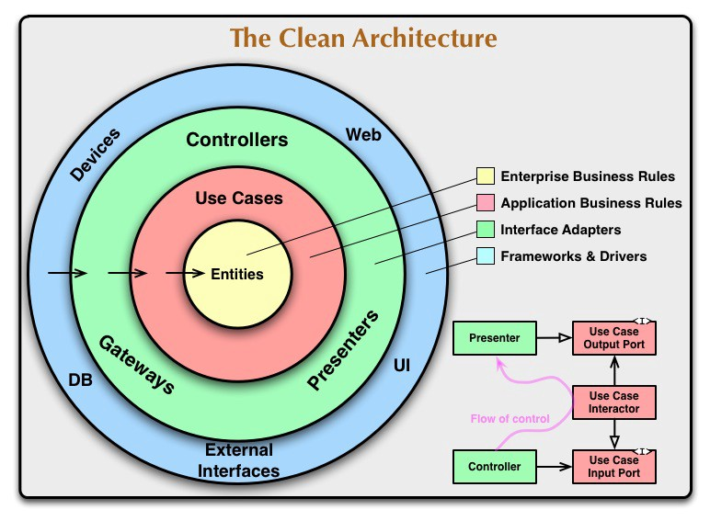
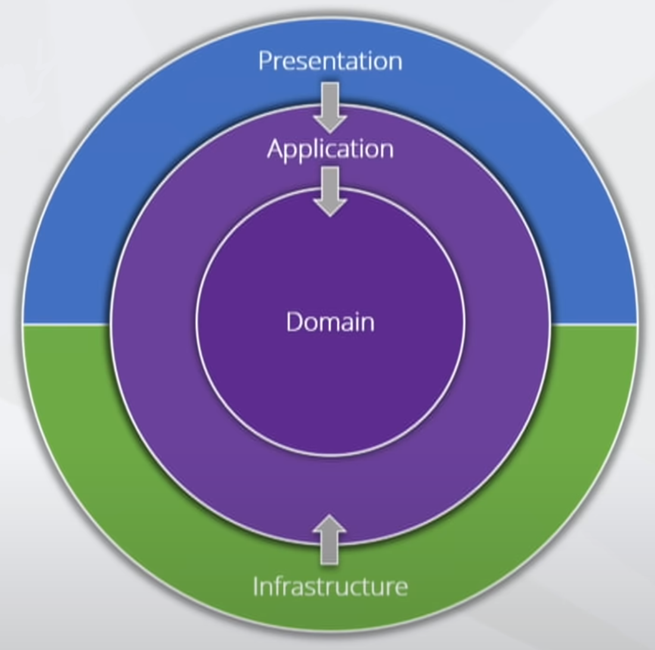

Slide 11
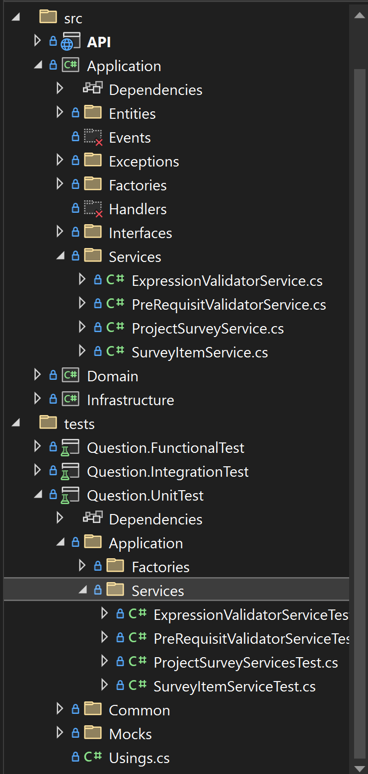

Slide 12
Other Architectures
Monolith
MVC
Hexagonal
Four Tier
…

Slide 13
Unit Testing

Slide 14
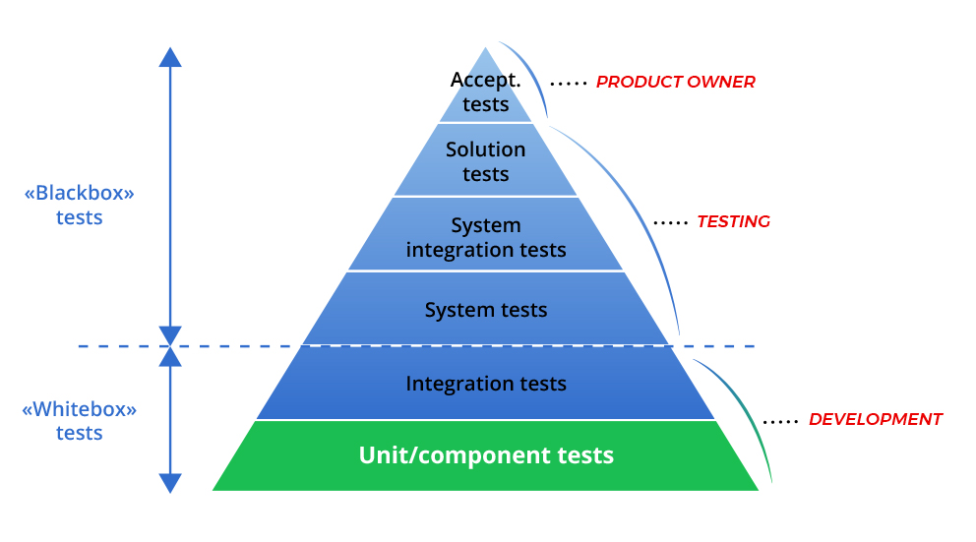

Slide 15
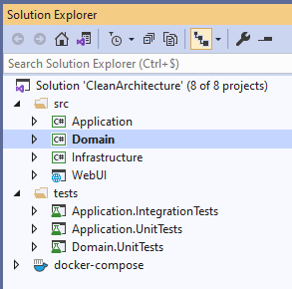
Folder Architecture

Slide 16
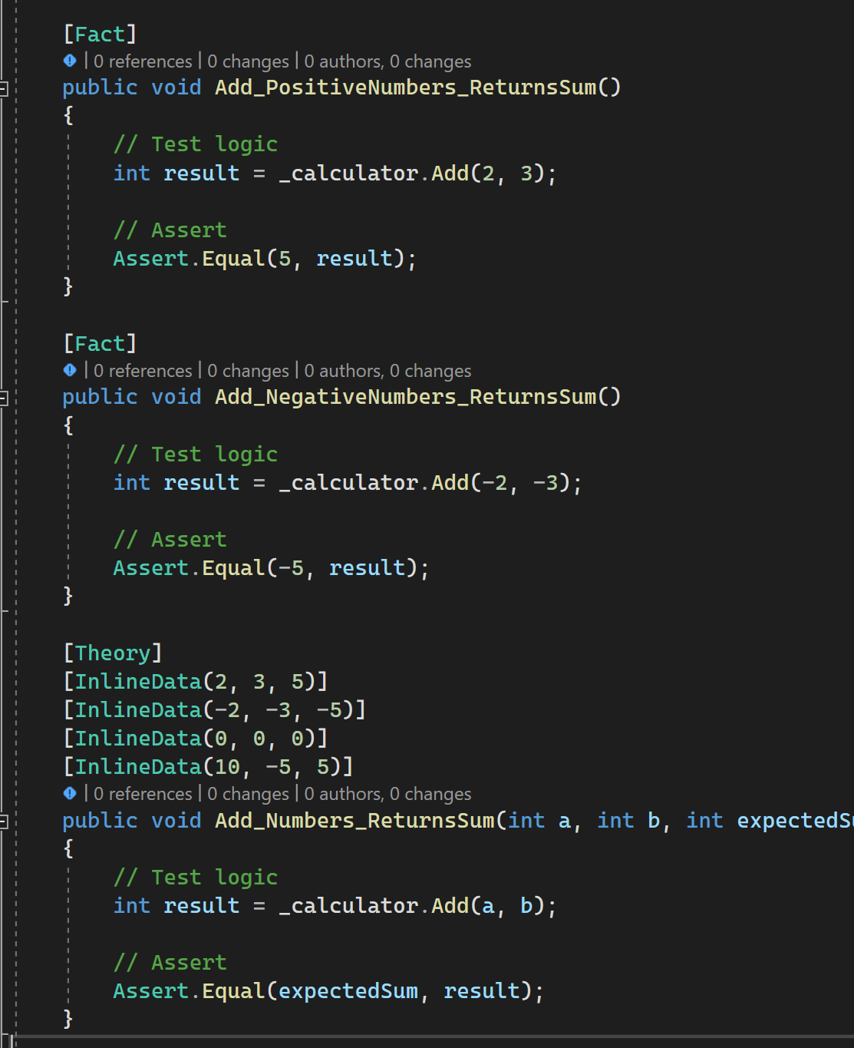
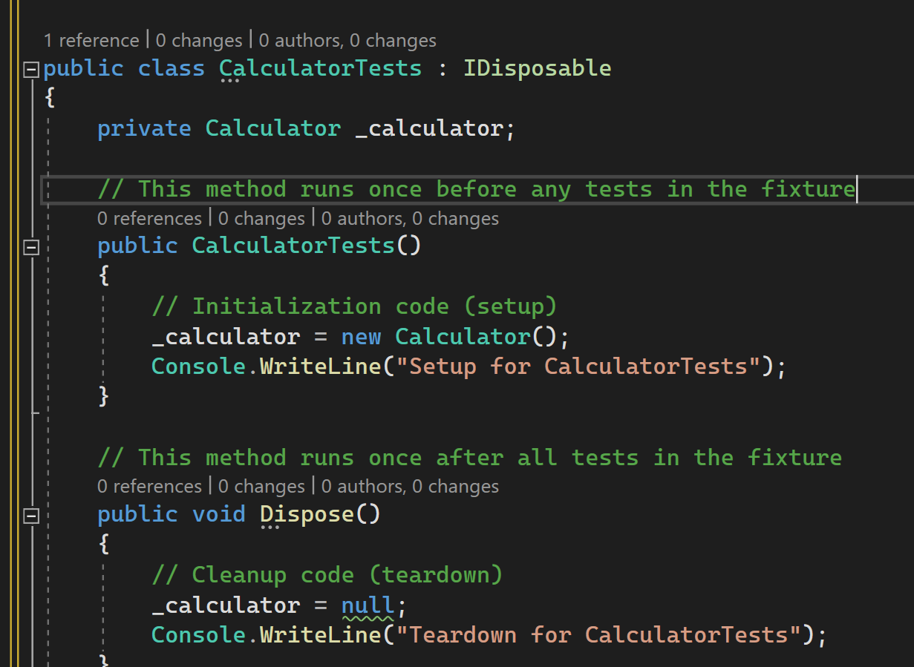
Test Structures
Setup
Test
Fact
Theory
Teardown

Slide 17
Function Name Structures
MethodName_StateUnderTest_ExpectedBehavior
CalculateTotal_WithValidInputs_ReturnsCorrectResult()
MethodNameShould_ExpectedBehavior:
SaveOrderShould_ThrowExceptionIfInvalidInput()
UnitOfWork__Scenario_ExpectedResult:
UserService_GetUserById_InvalidId_ReturnsNull()
Should_ExpectedBehavior_WhenState
SortArray_ShouldReturnSortedArray_WhenUnsorted()
MethodName_ReturnValue_Condition
DivideNumber_ReturnCorrectResult_WhenBothPositiive()
DivideNumber_ThrowException_WhenDonomeZero()
...

Slide 18
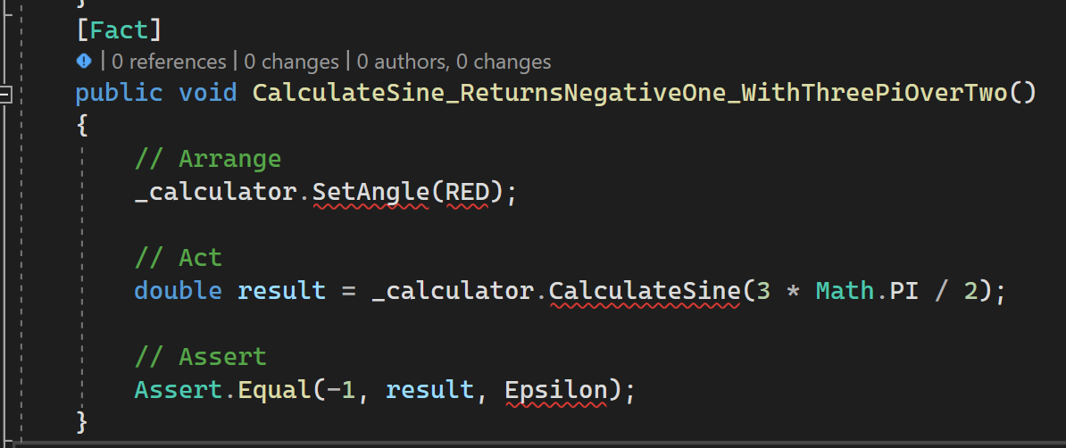
Function Structures

